Slide 1
To replace with my own drawing

Slide 2
CSS143 Computer Programming (II)

Slide 3

Code-Along
Write a function to reverse an integer array

Slide 4
Write a function to reverse an integer array in place
5
3
12
10
1
18
7
7
18
1
10
12
3
Input:
5
output:
0
1
2
3
4
5
6
0
1
2
3
4
5
6
“in place” means “without using additional memory space”

Slide 5
Coding Procedures
First, write Tests
Test should fail
Then, implement Feature
Test should pass
And then, refactor
Test should still Pass

Slide 6

How do you test your reverse function?
reverse twice, it’ll be back to the input
[1, 3, 5] → [5, 3, 1] → [1, 3, 5]

Slide 7

Write a function to reverse an integer array in place

Slide 8
Swap
Swap
5
18
7
12
1
7
18
12
5
0
1
2
3
4
How many steps？

Slide 9

Get starter code from here:
https://github.com/pdgetrf/code-along-reverse-array.git

Slide 10
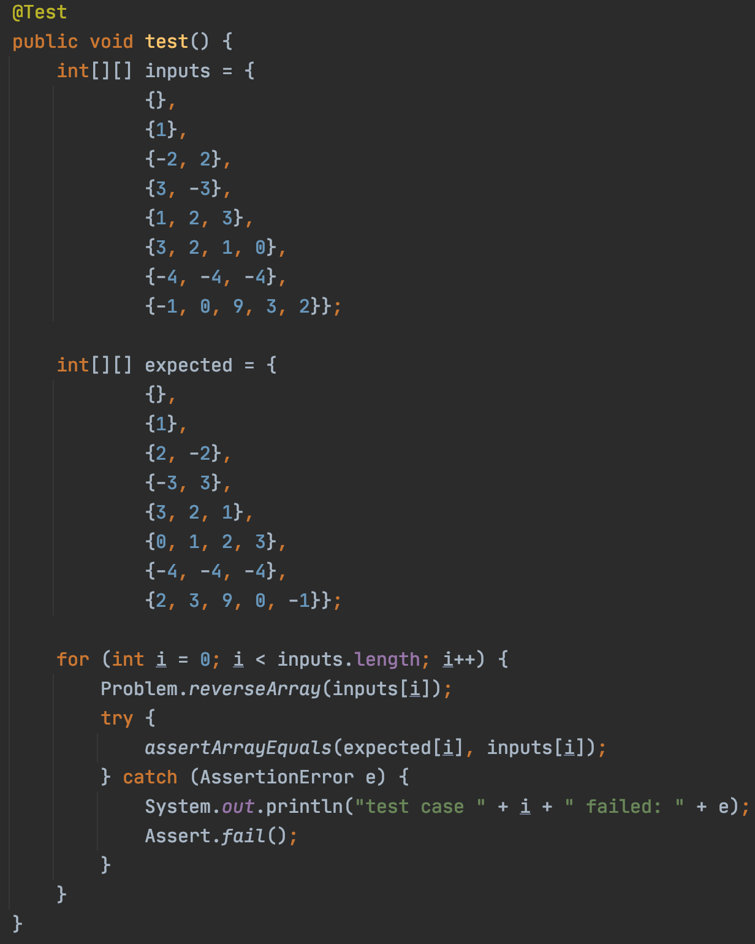
First, write Tests
Then, implement Feature
And then, refactor
Test failing as expected

Slide 11
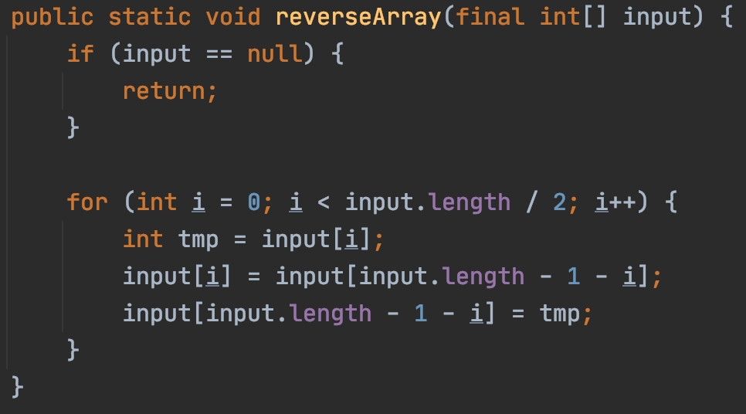
First, write Tests
Then, implement Feature
And then, refactor
Test Passed

Slide 12
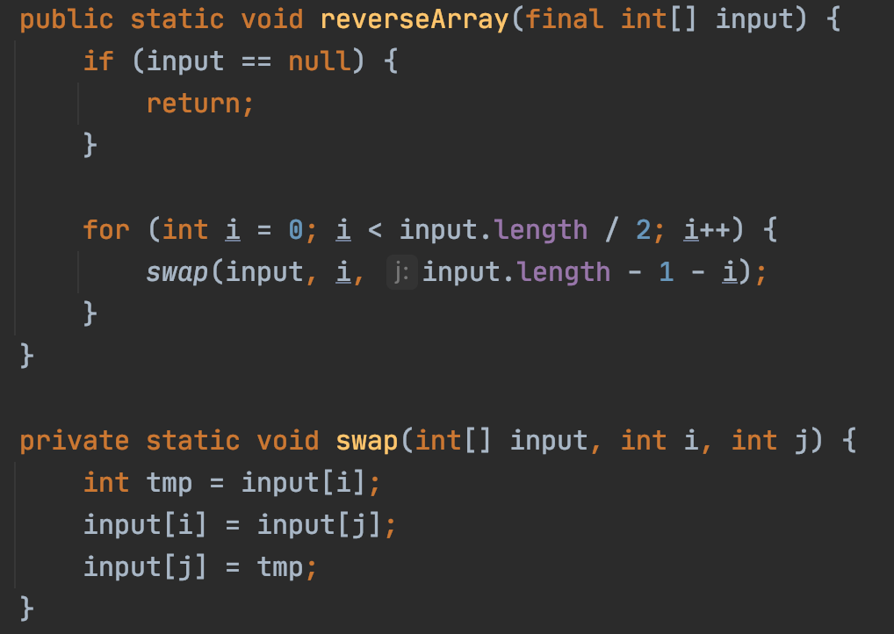
First, write Tests
Then, implement Feature
And then, refactor
Test Passed

Slide 13
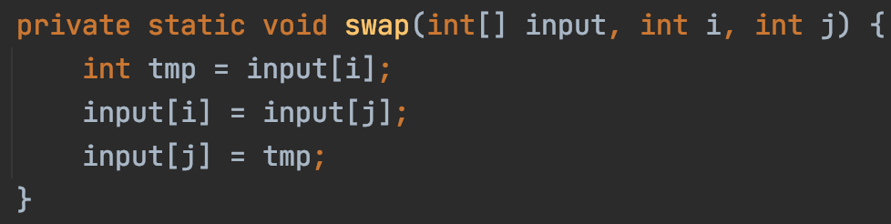
First, write Tests
Then, implement Feature
And then, refactor
can you do the swap without using this extra variable?

Slide 14
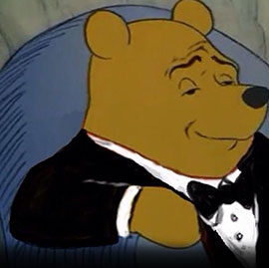
Swap two numbers without temp variable
a’ = a - b b’ = b’ + a’ a’’ = b’ – a’
Doesn’t work when a == b

Slide 15
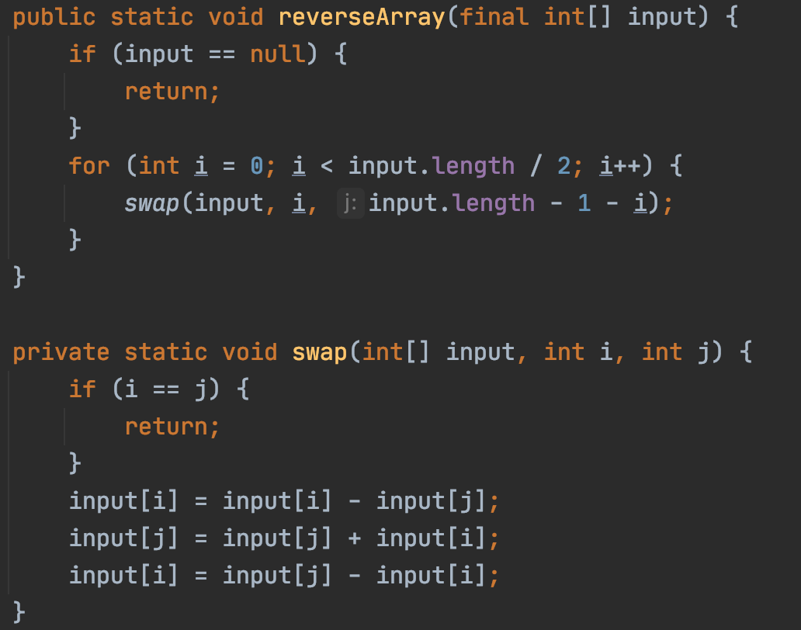
First, write Tests
Then, implement Feature
And then, refactor
Test Passed

Slide 16
Object Orient Programming Review

Slide 17
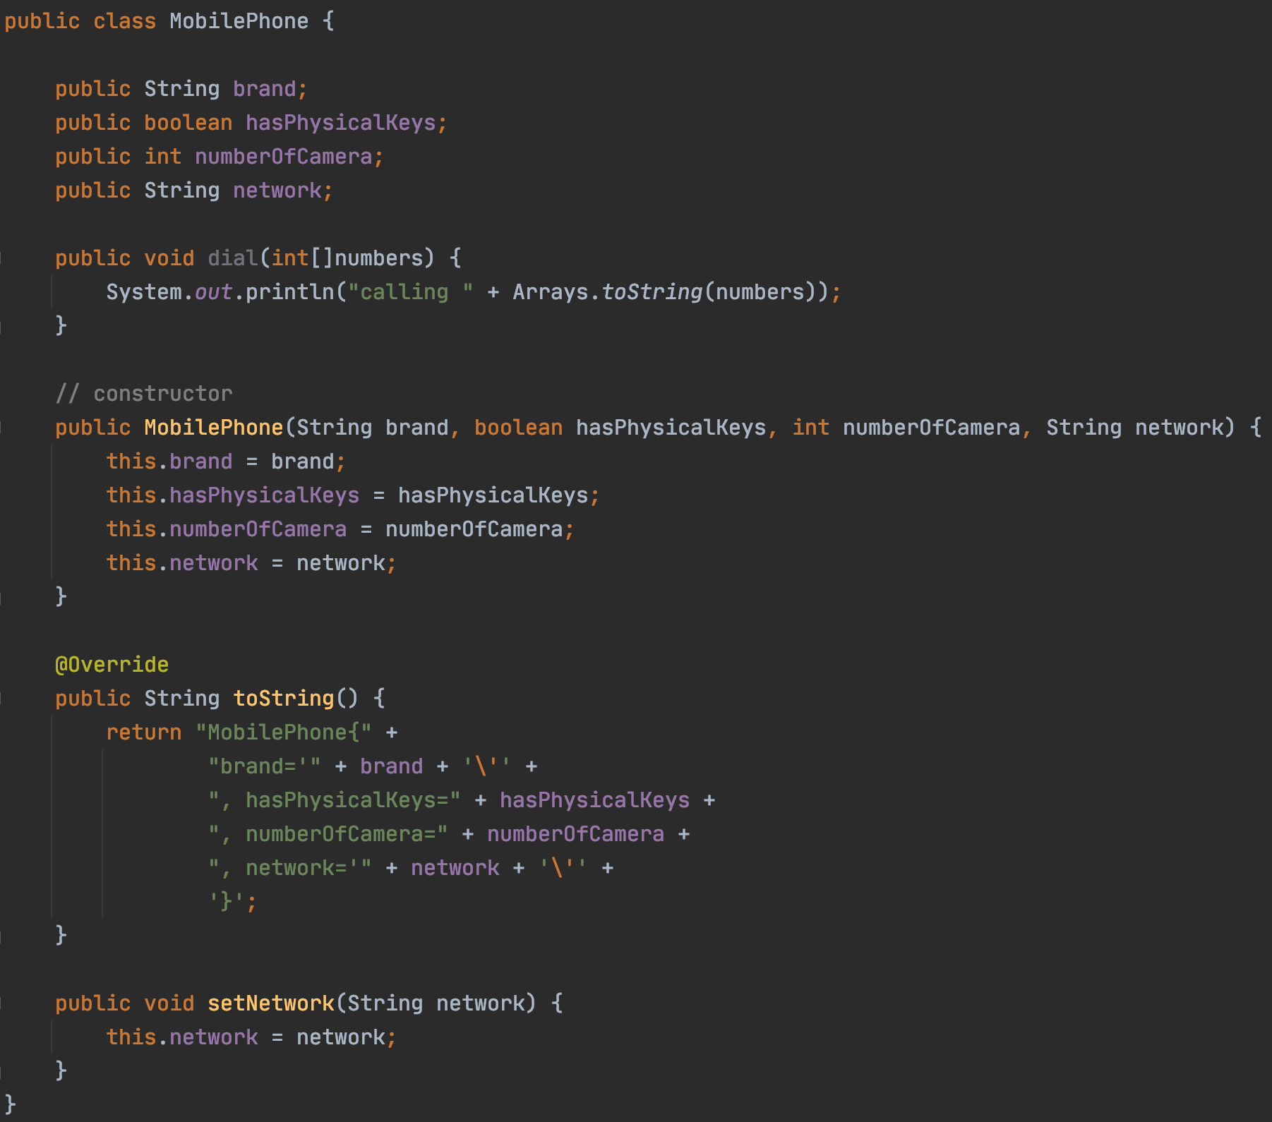
Class vs Object vs Instance vs Reference
A mobile phone, cell phone, cellphone, or hand phone, sometimes shortened to simply mobile, cell or just phone, is a portable telephone that can make and receive calls over a radio frequency link while the user is moving within a telephone service area. ---wikipedia
Mobile Phone
Class

Slide 18
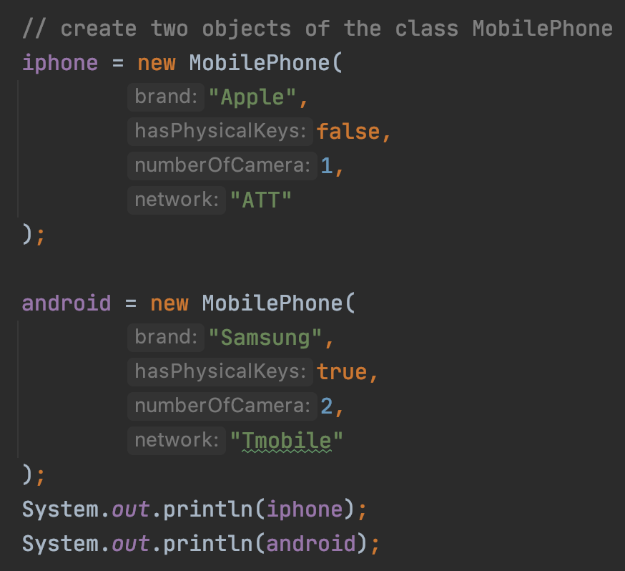
Class vs Object vs Instance vs Reference
iphone reference
0
2
1
2
iphone object
3
4
5
android reference
6
9
7
8
9
android object
10
11
Object/Instance

Slide 19
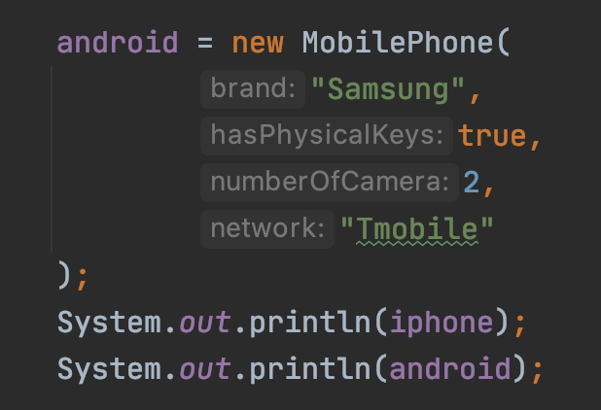
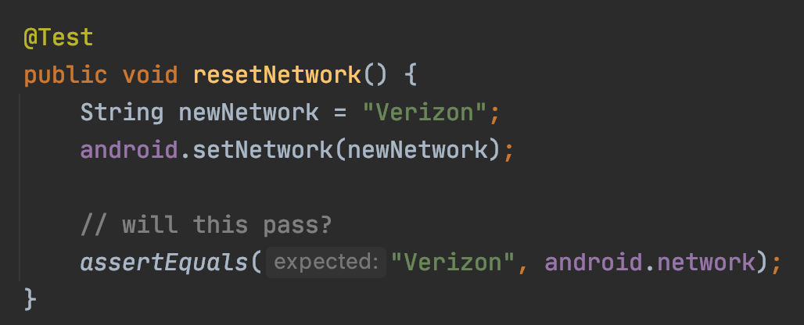
Class vs Object vs Instance vs Reference
0
2
1
2
3
4
5
6
9
7
8
9
10
11

Slide 20
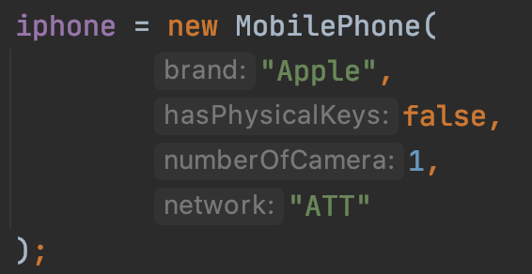
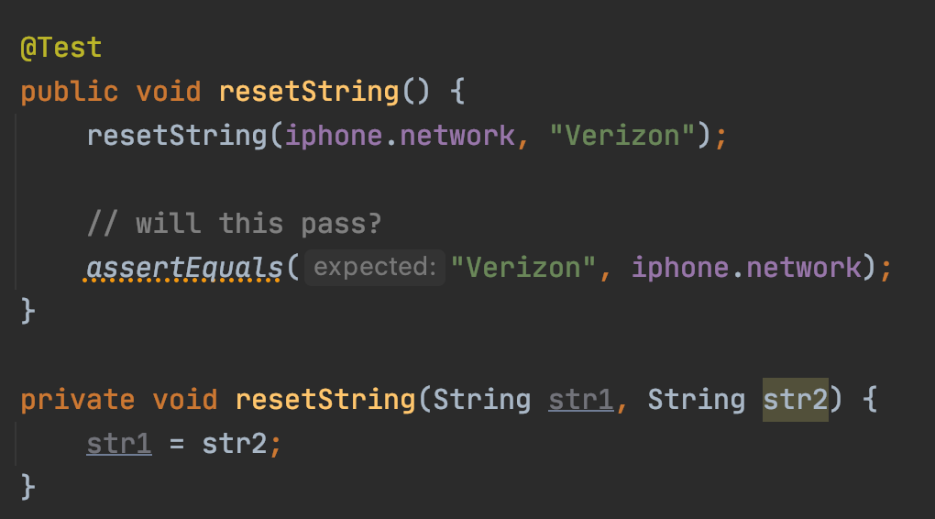
Class vs Object vs Instance vs Reference
0
1
iphone.network
2
“ATT”
3
4
str1
5
6
7
8
“Verizon”
9
10
11
More on string passing https://theopentutorials.com/tutorials/java/strings/passing-string-as-parameter-to-a-method

Slide 21
Class vs Object vs Instance vs Reference
Java always pass by ”value”
The value of a primitive type is its value
The value of an object type is its reference
this example code: https://github.com/pdgetrf/PassByWhat
More discussion https://www.geeksforgeeks.org/passing-and-returning-objects-in-java

Slide 22
Class Exercise
Implement a class for cats
Member Variables:
Name
Gender
Age
Member Methods:
Speak
Play

Slide 23
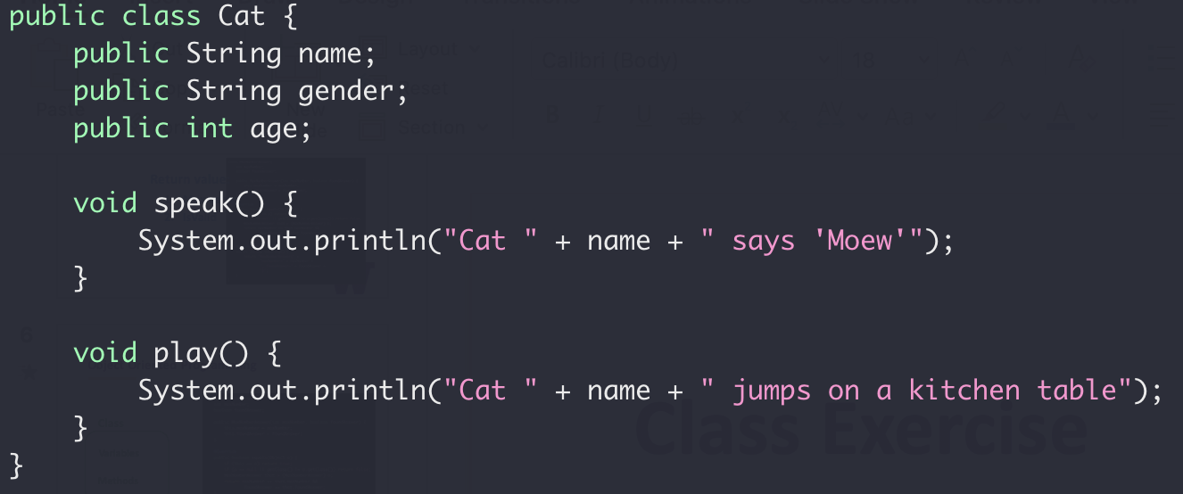
Class Exercise
Implement a class for cats

Slide 24
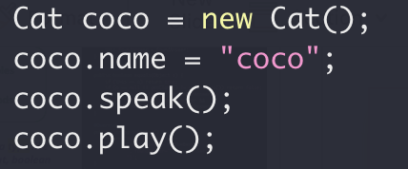
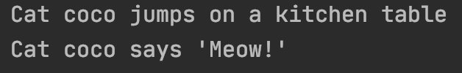
Class Exercise
Implement a class for cats

Slide 25
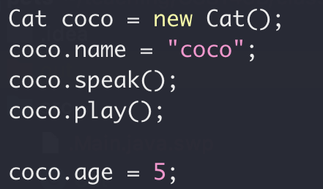
Encapsulation
Nop!
Your age is 5.
Me
☹

Slide 26
Encapsulation
Class
Variables
Variables
Setter/Getter
public Methods
Access
private Methods
Read/Write
Methods

Slide 27
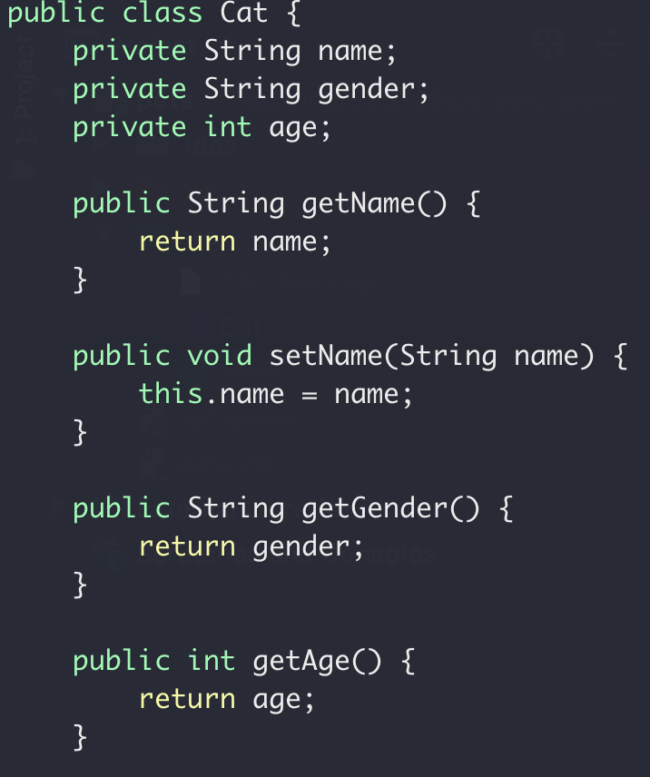
Class Exercise
Setter and Getter

Slide 28
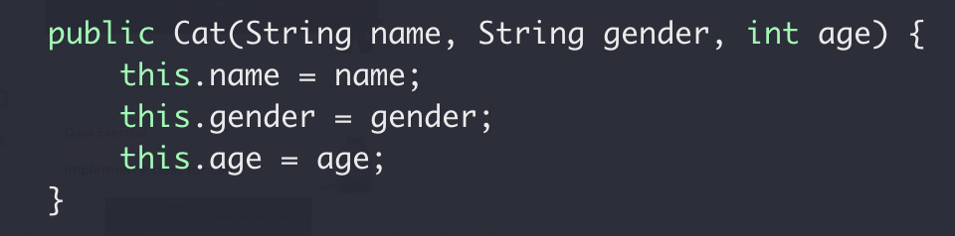
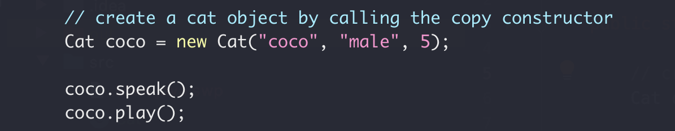
Class Exercise
Constructor

Slide 29
Encapsulation Summary
Group properties (variables) and methods (that work on properties) into a single concept call “class”
Group properties (variables) and methods (that work on properties) into a single concept call “class”
Member variables should be private (not exposed to outside)
Member variables should be private (not exposed to outside)
What’s the default access level? Public or private?
Constructor to set/initialize members when creating object
Constructor to set/initialize members when creating object
Setter/getter for member properties access

Slide 30
Class Exercise
Implement a class for dogs
Member Variables:
Name
Gender
Age
Member Methods:
Speak
Play

Slide 31
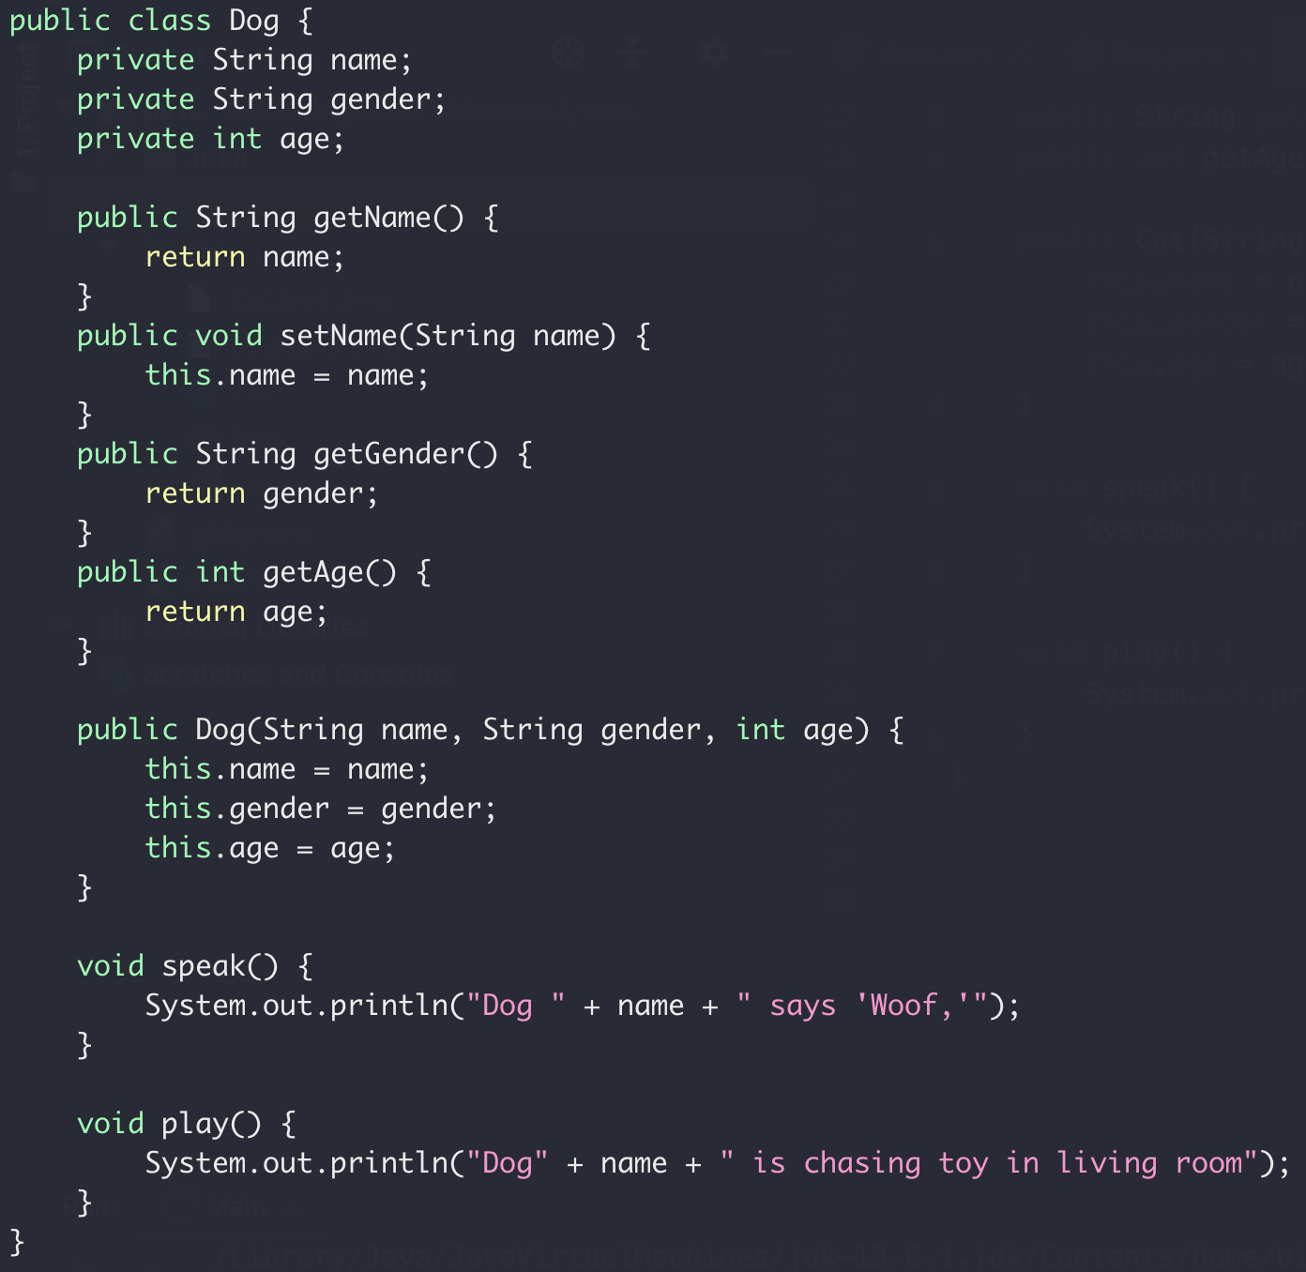
Class Exercise
Implement a class for dogs

Slide 32
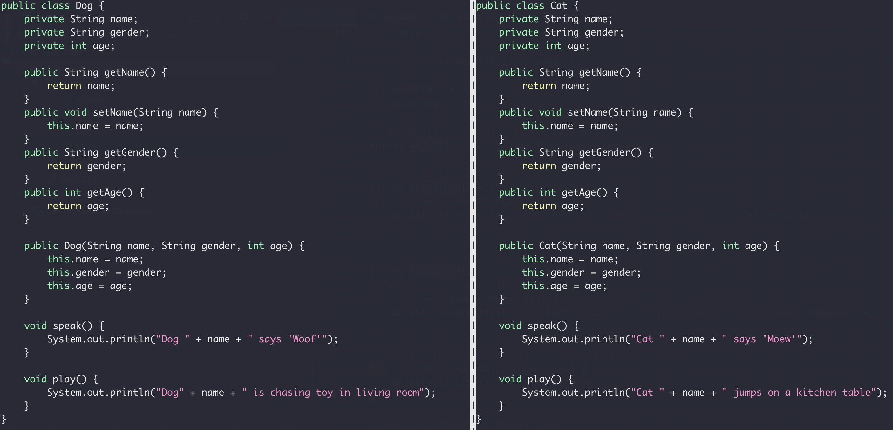
Inheritance
Compare the Cat and Dog class
Duplicated

Slide 33
Inheritance
Animal Class
Name
Gender
Age
Dog Class
Cat Class
Name
Gender
Age
Name
Gender
Age

Slide 34
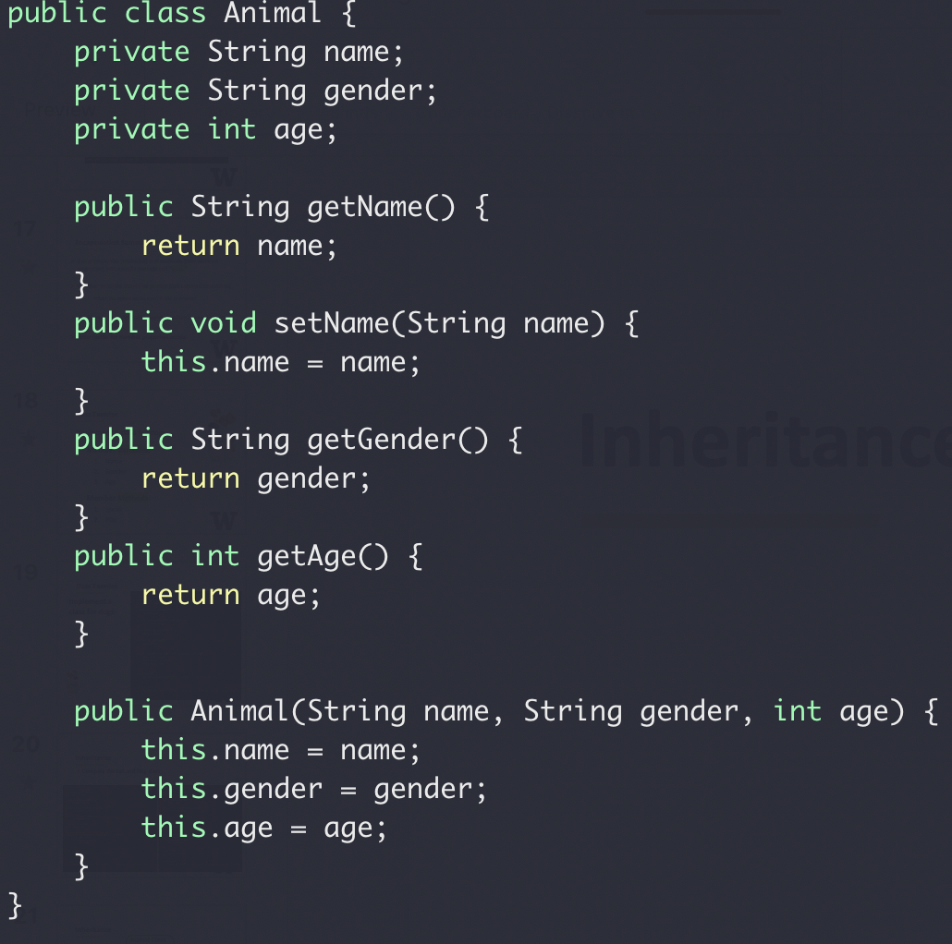
Inheritance
Animal Class
Name
Gender
Age
Base class constructor

Slide 35
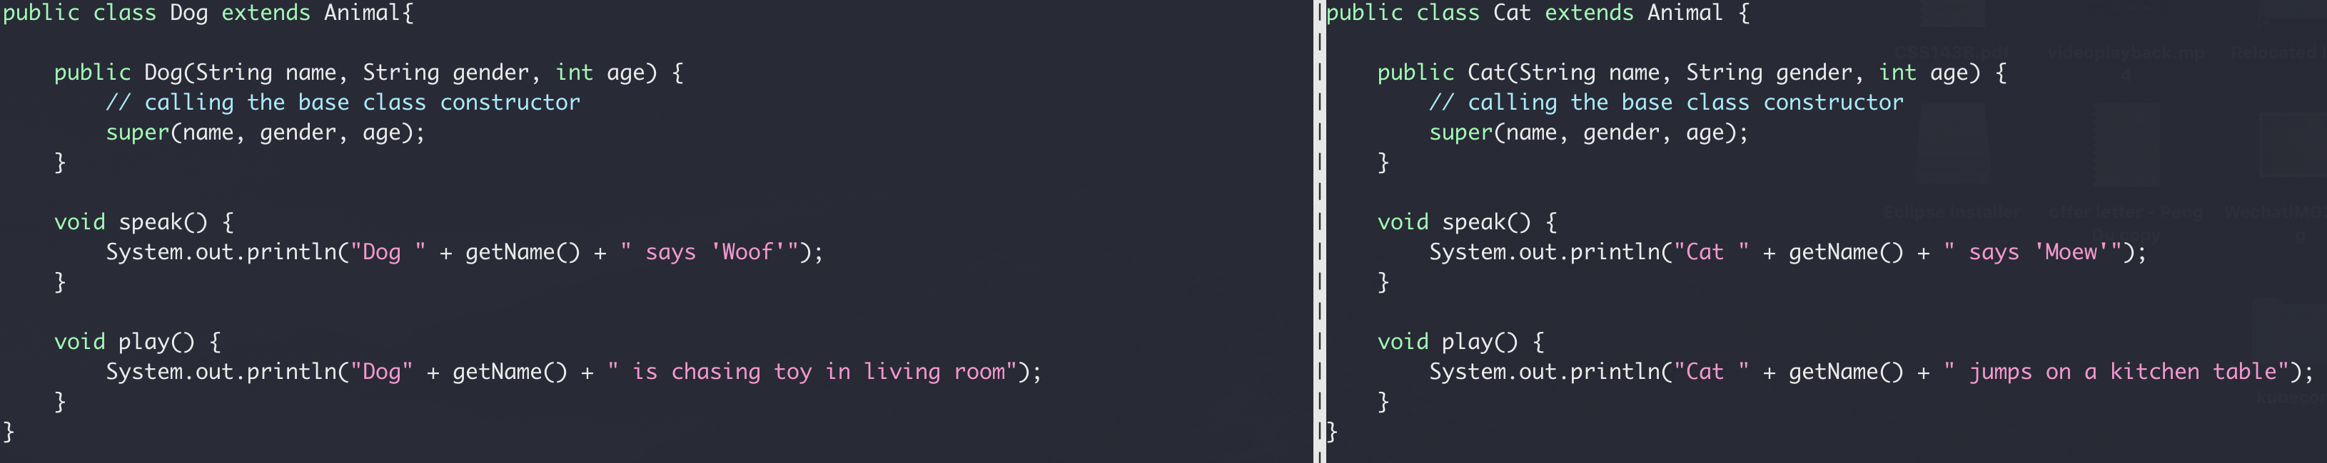
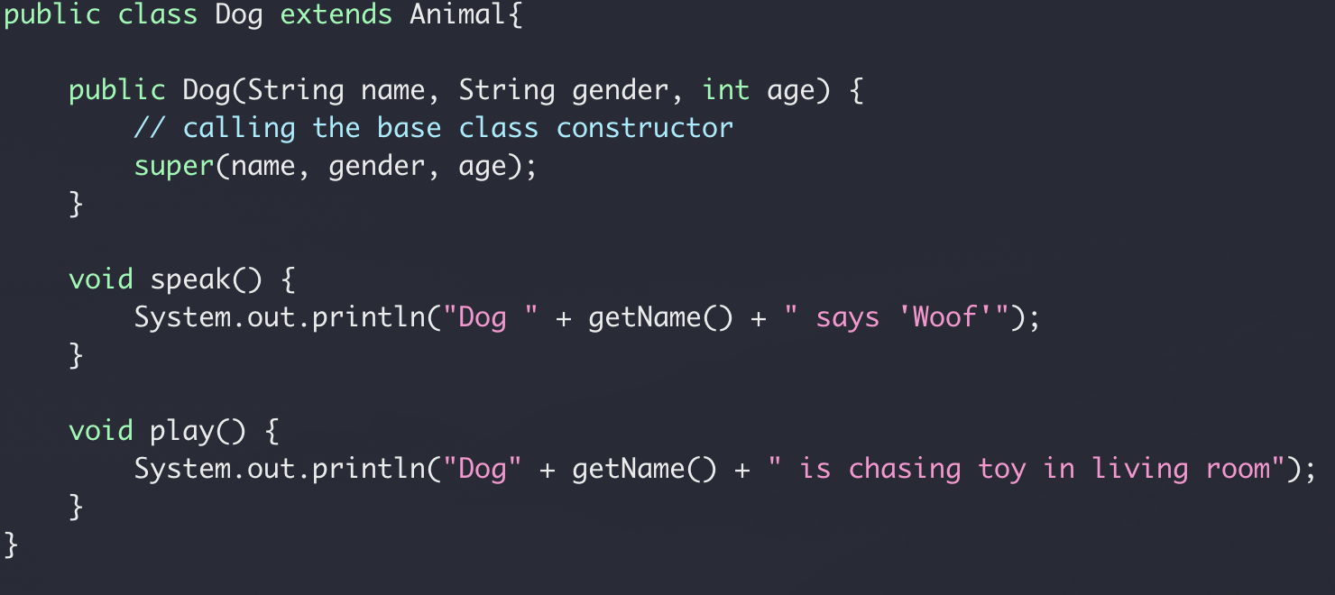
Inheritance
Compare the Cat and Dog class
inheritance
Calling based class constructor

Slide 36
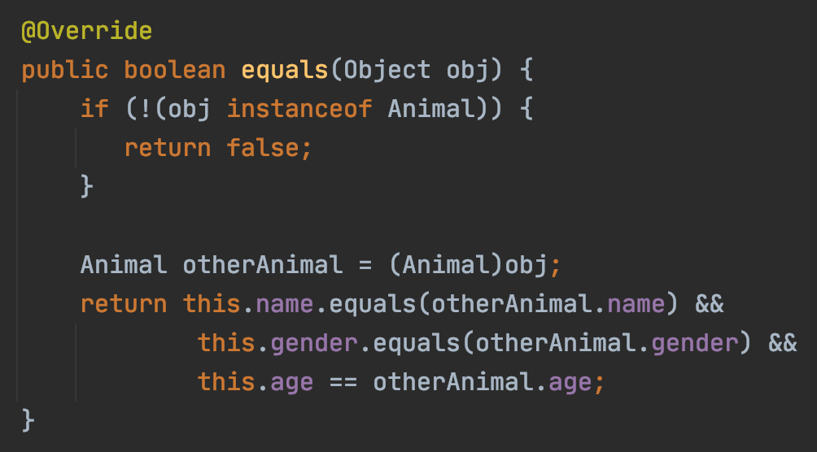
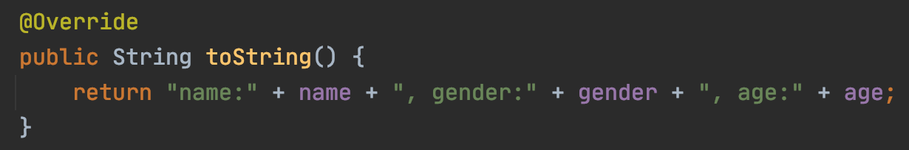
Inheritance
In Java, all classes are derived from the Object class
Yes, your own class too!
Override of the Object class equal() and toString()

Slide 37
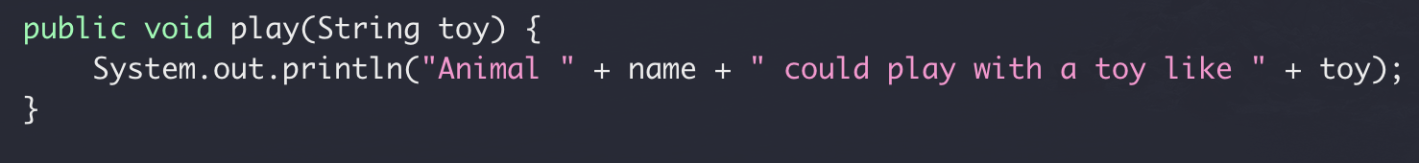
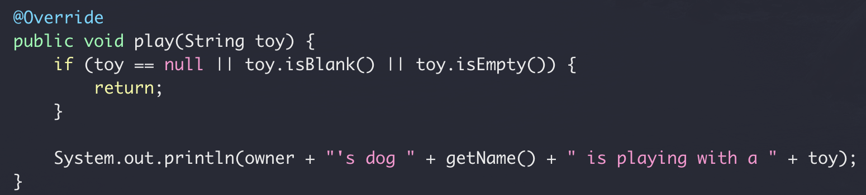
Override vs Overload
Override
Re-implement a function in derived class from base class with the
same name
same signature
Base class: Animal.Java
Derived class: Dog.Java

Slide 38
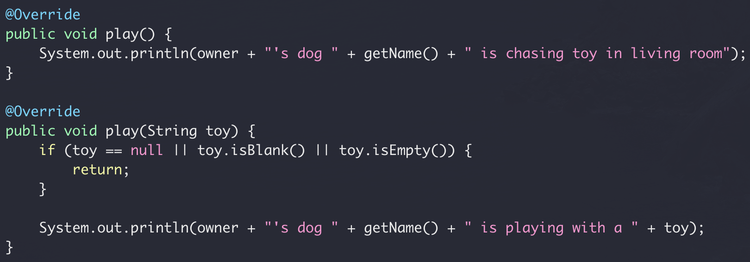
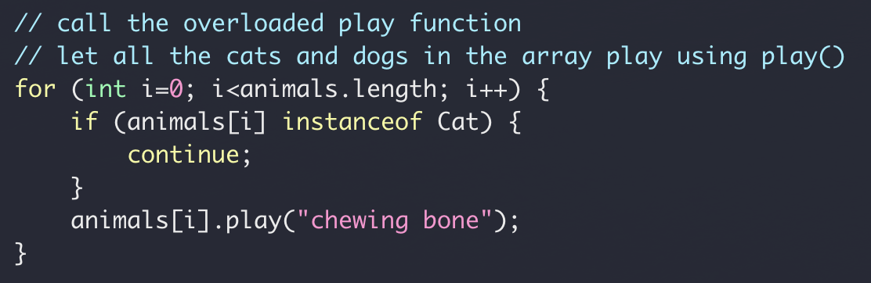
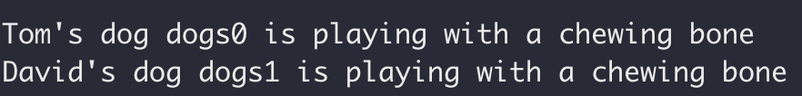
Override vs Overload
Overload
Re-implement a function in the same class
same name
different signatures
Derived class: Dog.Java

Slide 39
Inheritance Summary
Base class & derived class
Use super to access the base
Override vs Overload

Slide 40
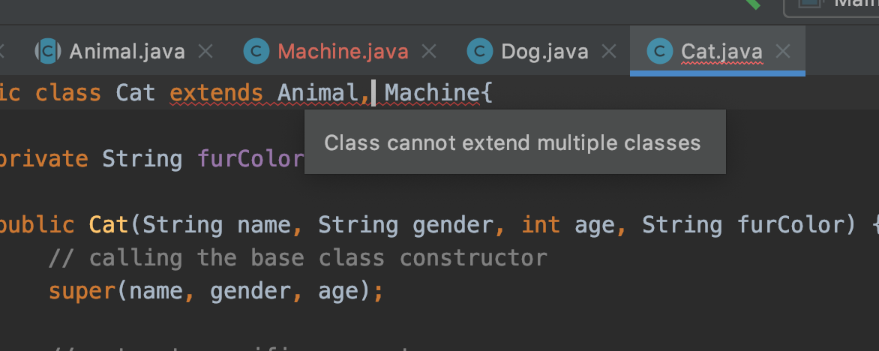
Inheritance Summary
Java does not support inheritance from multiple classes
Java does support inheritance from multiple interfaces
Class A
Class B
Class C
But why?

Slide 41
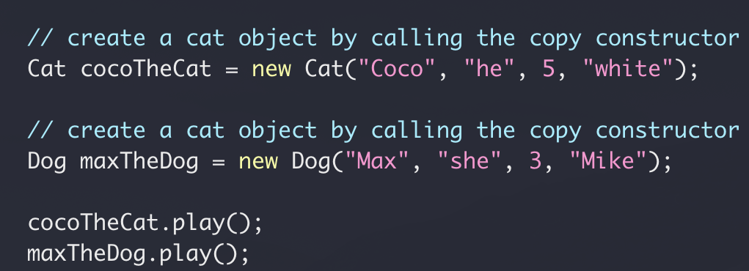
Class Exercise
Let all cats and dogs play
What if we have 300 cats and 200 dogs?
What if we have 3 cats and 2 dogs?

Slide 42
Polymorphism
Animal Class
public void play()
Dog Class
Cat Class
public void play()
public void play()

Slide 43
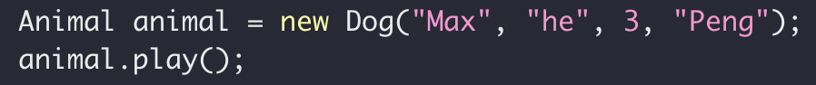
Polymorphism
Dog Instance
Assignment
Animal variable
public void play()

Slide 44
Polymorphism
Cat Instance
Assignment
Animal variable
public void play()

Slide 45

Polymorphism
Same reference type (base class), different objects (derived class)
“late binding”

Slide 46
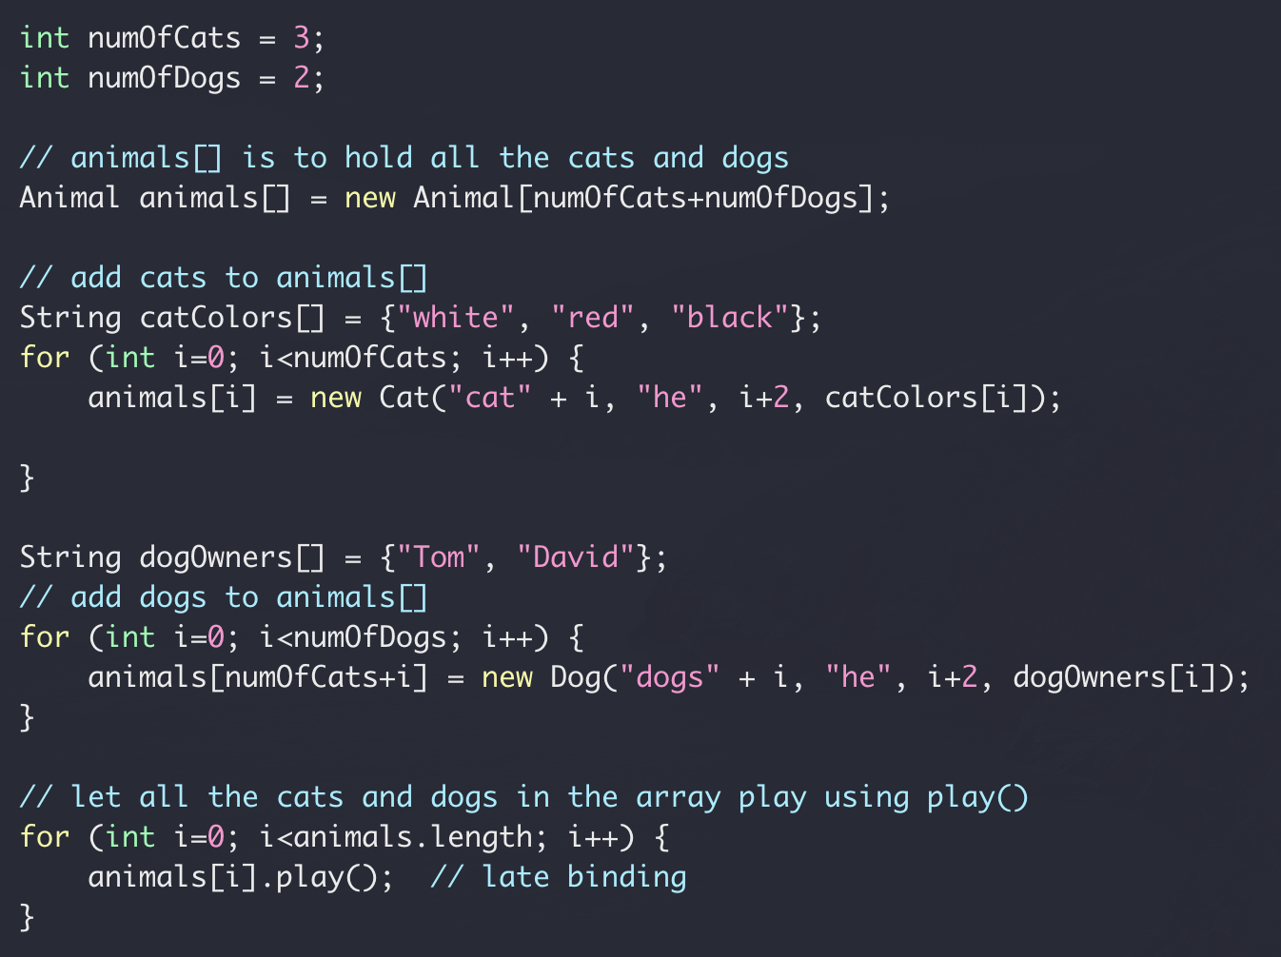
Polymorphism

Slide 47
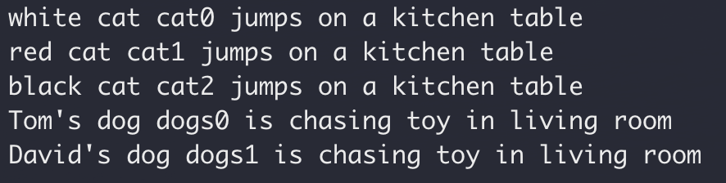
Polymorphism

Slide 48
Polymorphism Summary
Overridden method
Access using base class instance reference
Late binding: actual method being invoked is determined at run time
A more amusing example here

Slide 49
Abstract Class
Animal Class
public void play()
public void play()
No need to implement
Dog Class
Cat Class
Dog Class
Cat Class
public void play()
public void play()
public void play()
public void play()

Slide 50
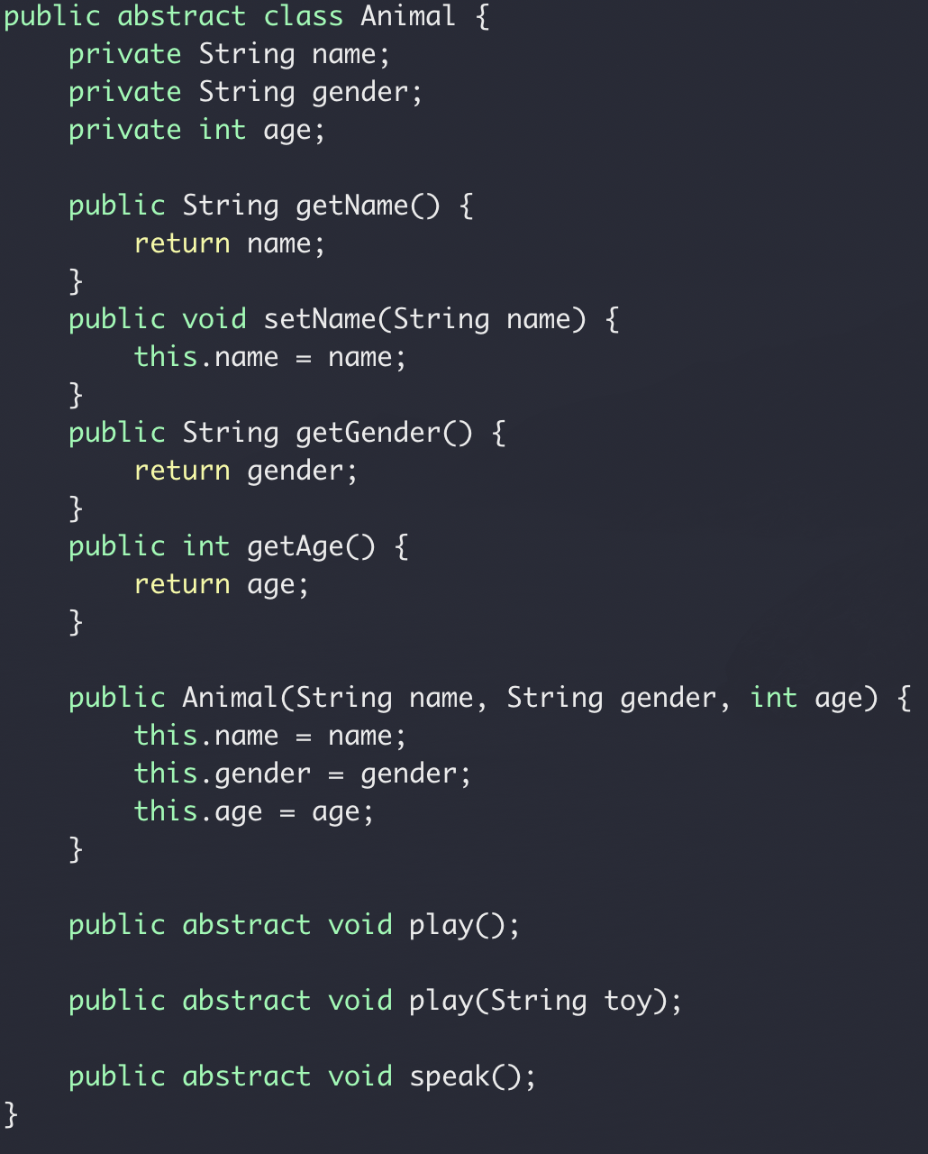
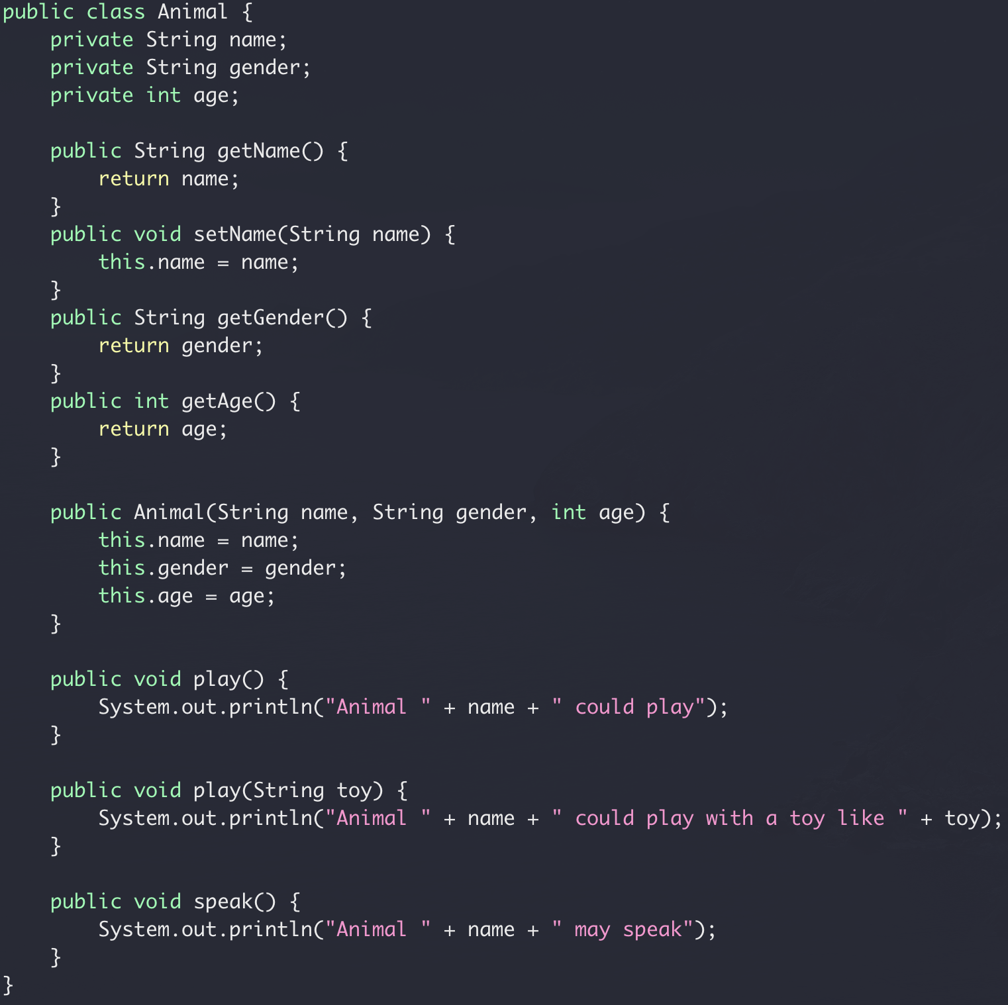
Abstract class

Slide 51

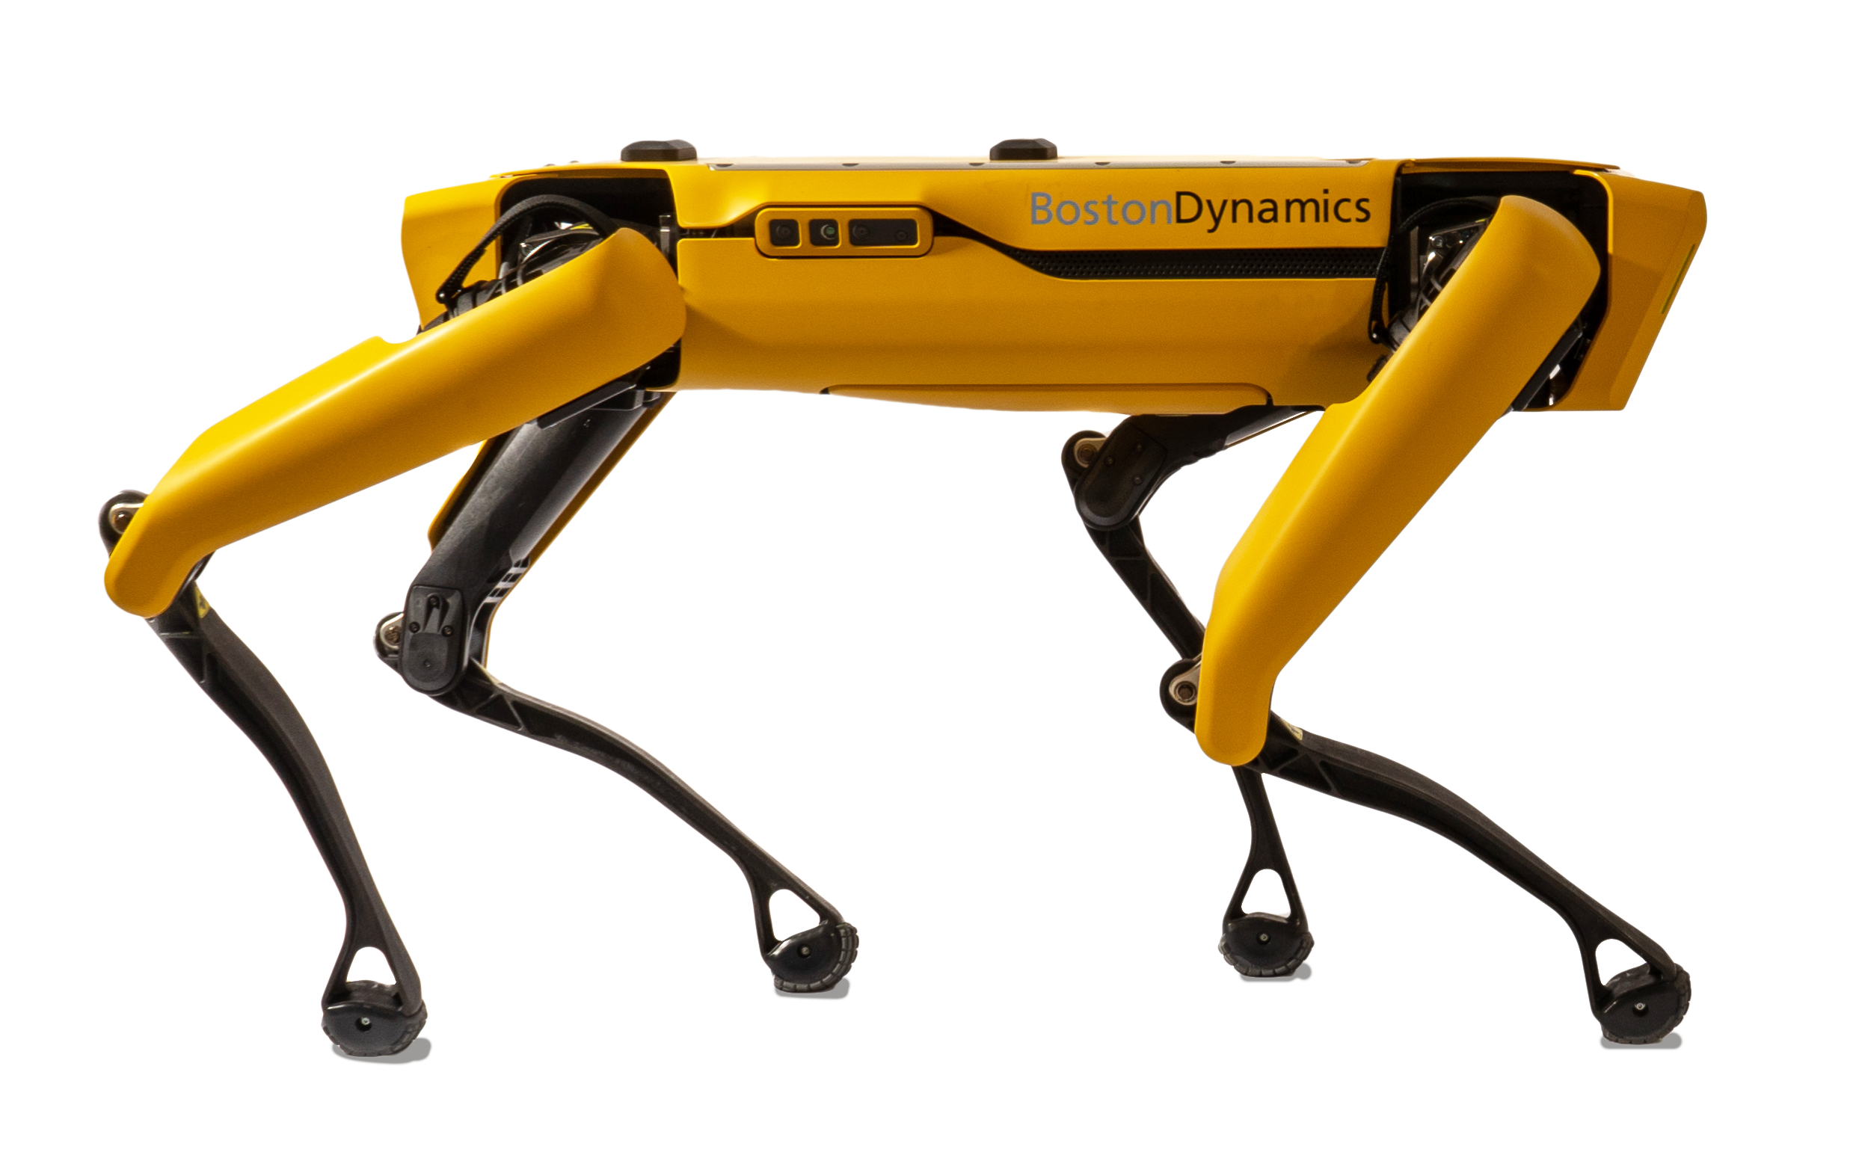

not just for Animal

Slide 52
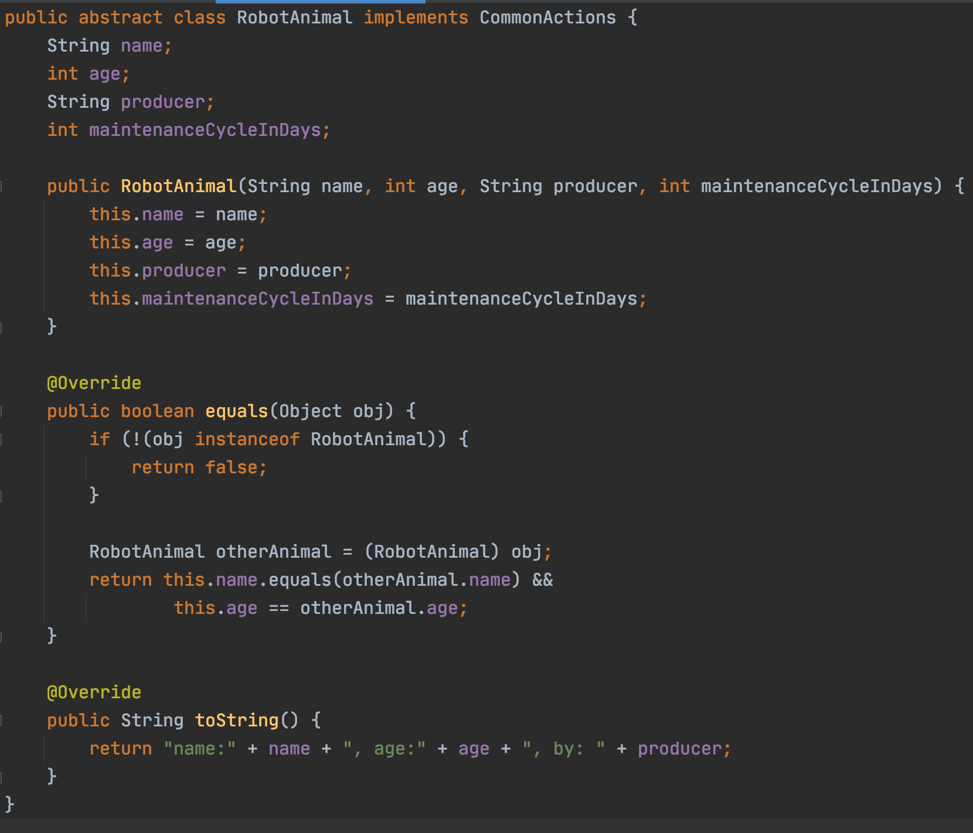
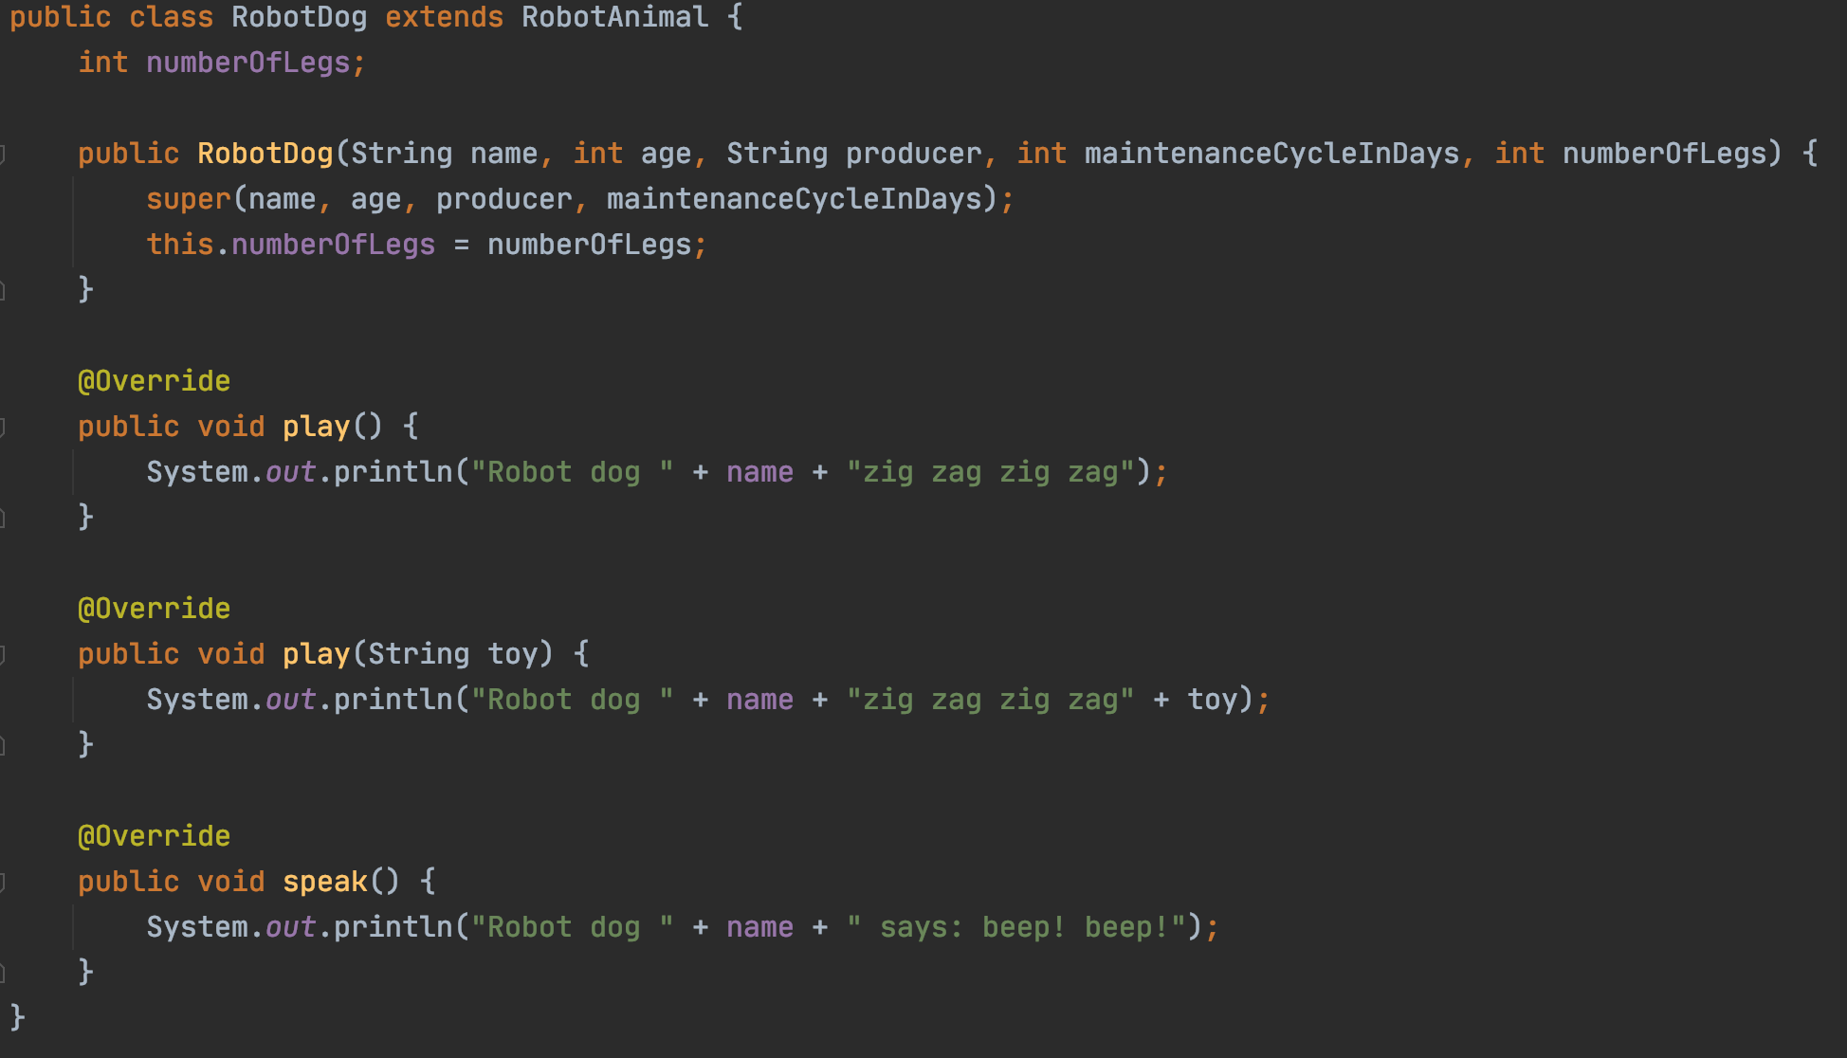
Base class
Derived class

Slide 53
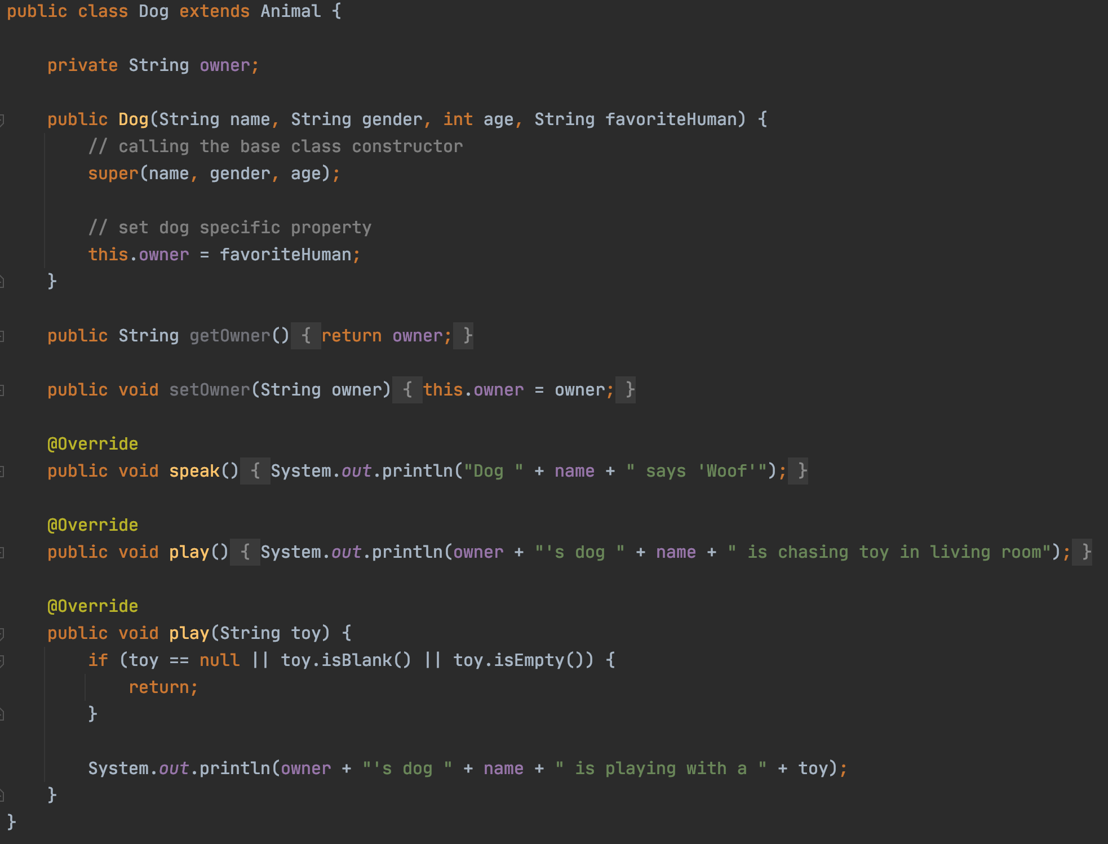
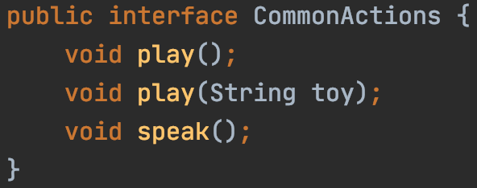
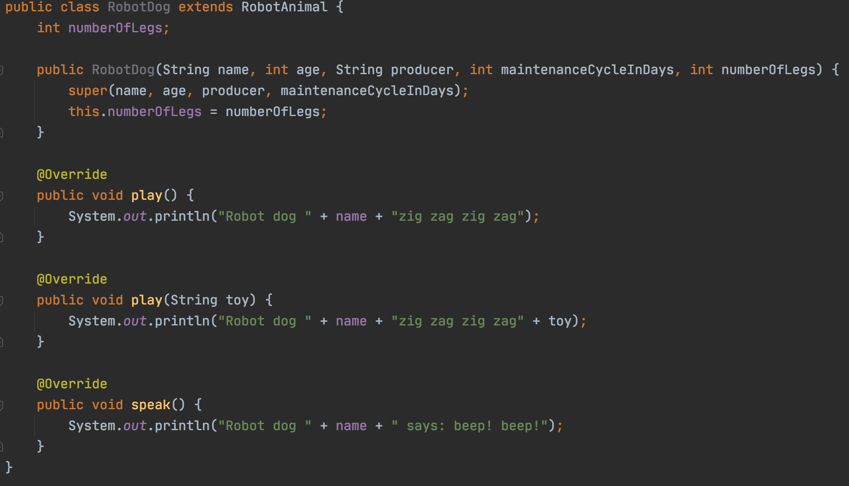


Slide 54
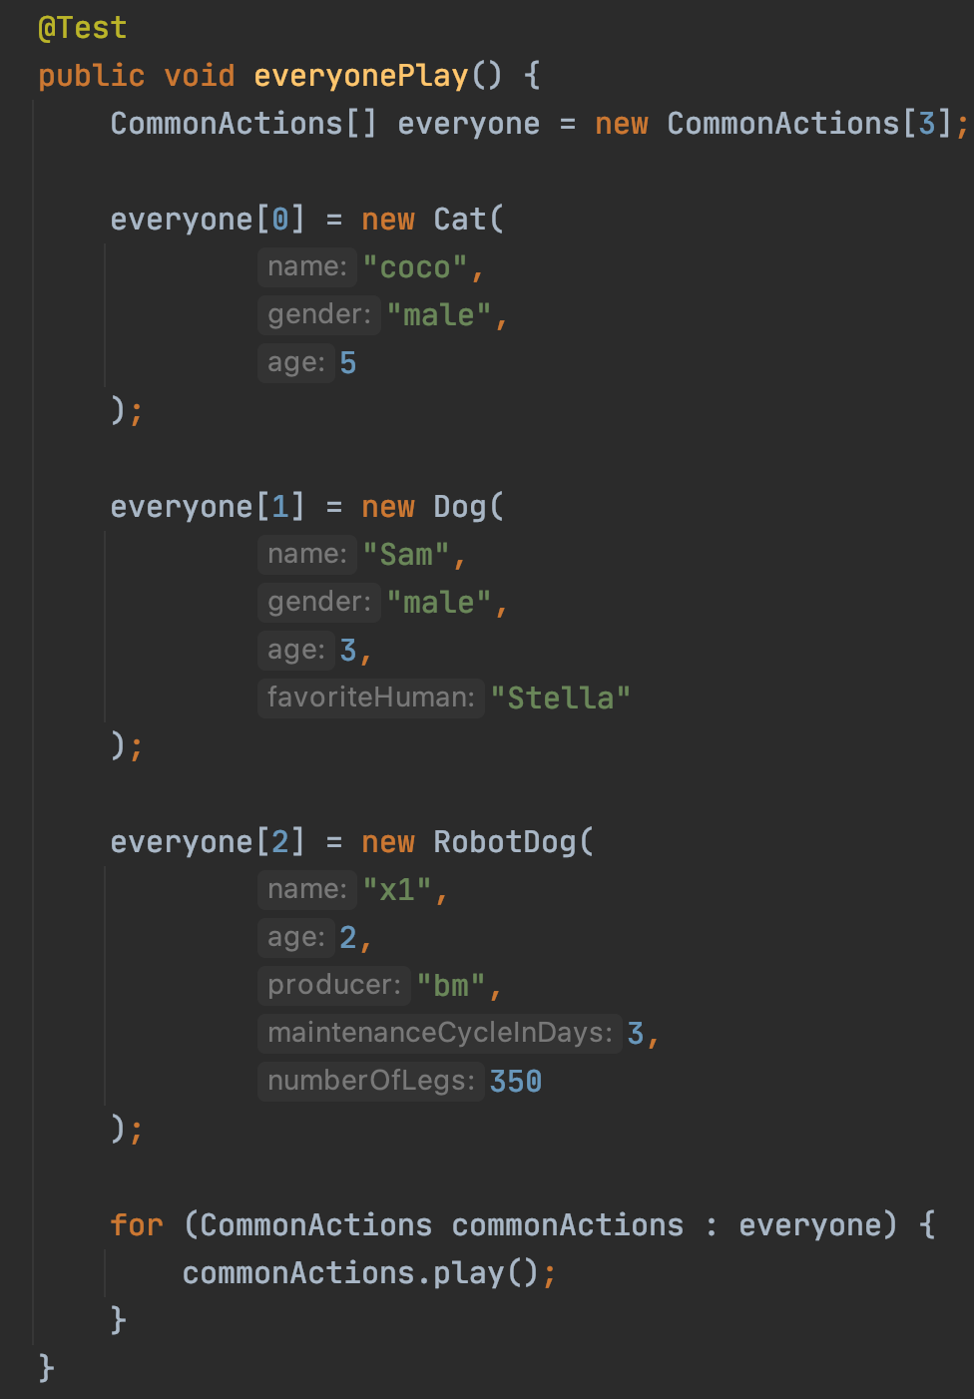
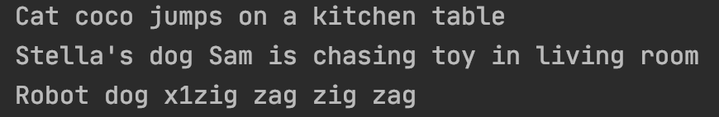
Now let’s have everyone play

Slide 55
Cat
Animal
extends
Dog
interface CommonActions
implements
RobotAnimal
RobotDog
Full code https://github.com/pdgetrf/OOBPet.git

Slide 56
OOP Review Summary
Encapsulation
Class vs Object/Instance vs Reference
Default access
Private member vs public method (setter/getter)
Inheritance
Base class and derived class
Calling base class copy constructor
Override vs Overload
Polymorphism
Accessing derived class object using base class reference

Slide 57

Homework
Homework 1 due Thursday midnight
Homework 2 will be assigned on Friday

Slide 58
Next Week
Homework 1 review
Abstract Data Type
List
Queue
Stack

